Slide 1
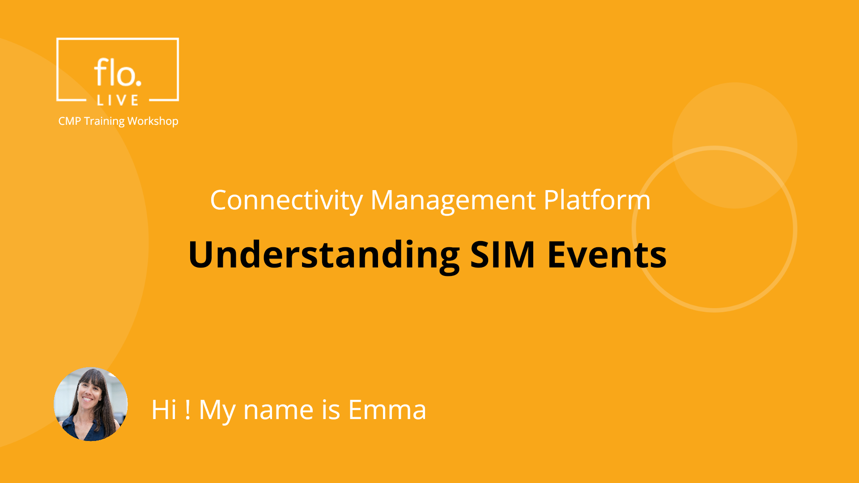
Notes:
Hi, My name is Emma and welcome to the CMP SIM Events Training Workshop.

Slide 2
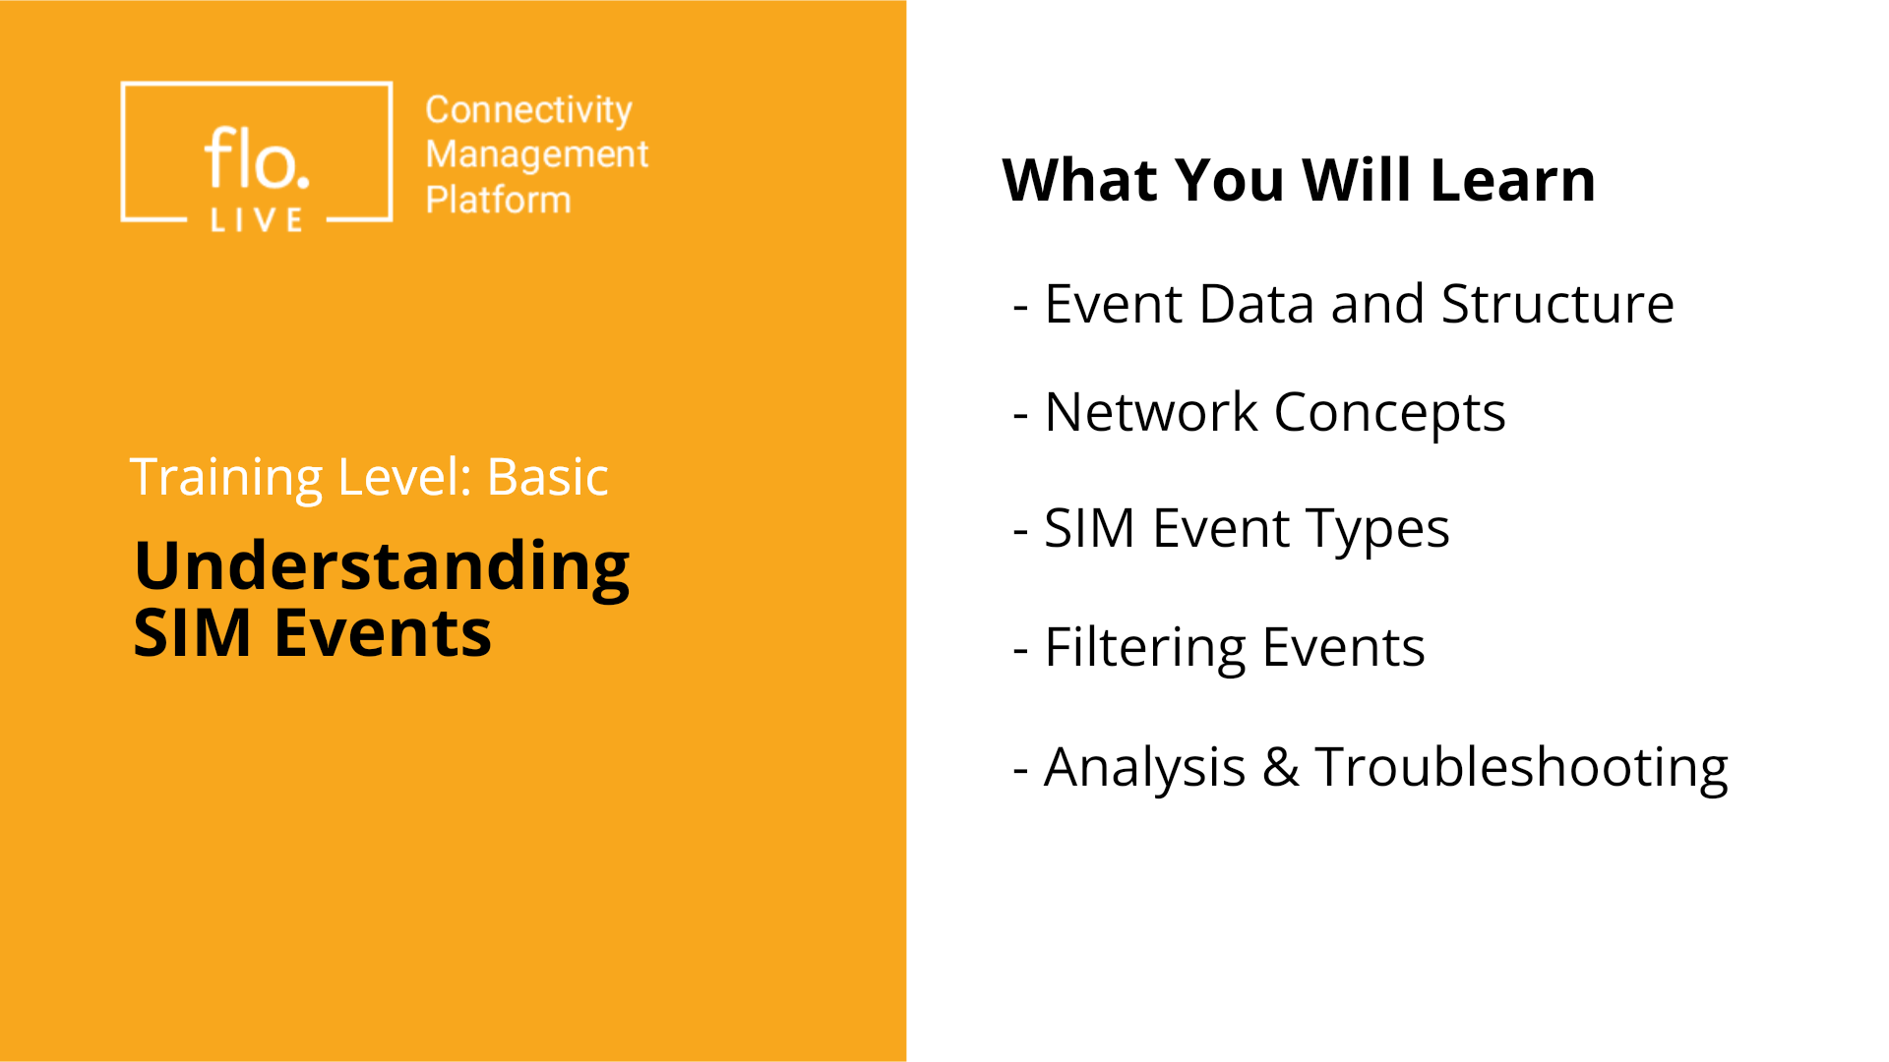
Notes:
In this tutorial we learn how to analyse SIM Events. We will learn about event data and structure, basic network concepts, and the different types of SIM events. We also explore how to filter events and troubleshoot common event related issues. Lets begin

Slide 3
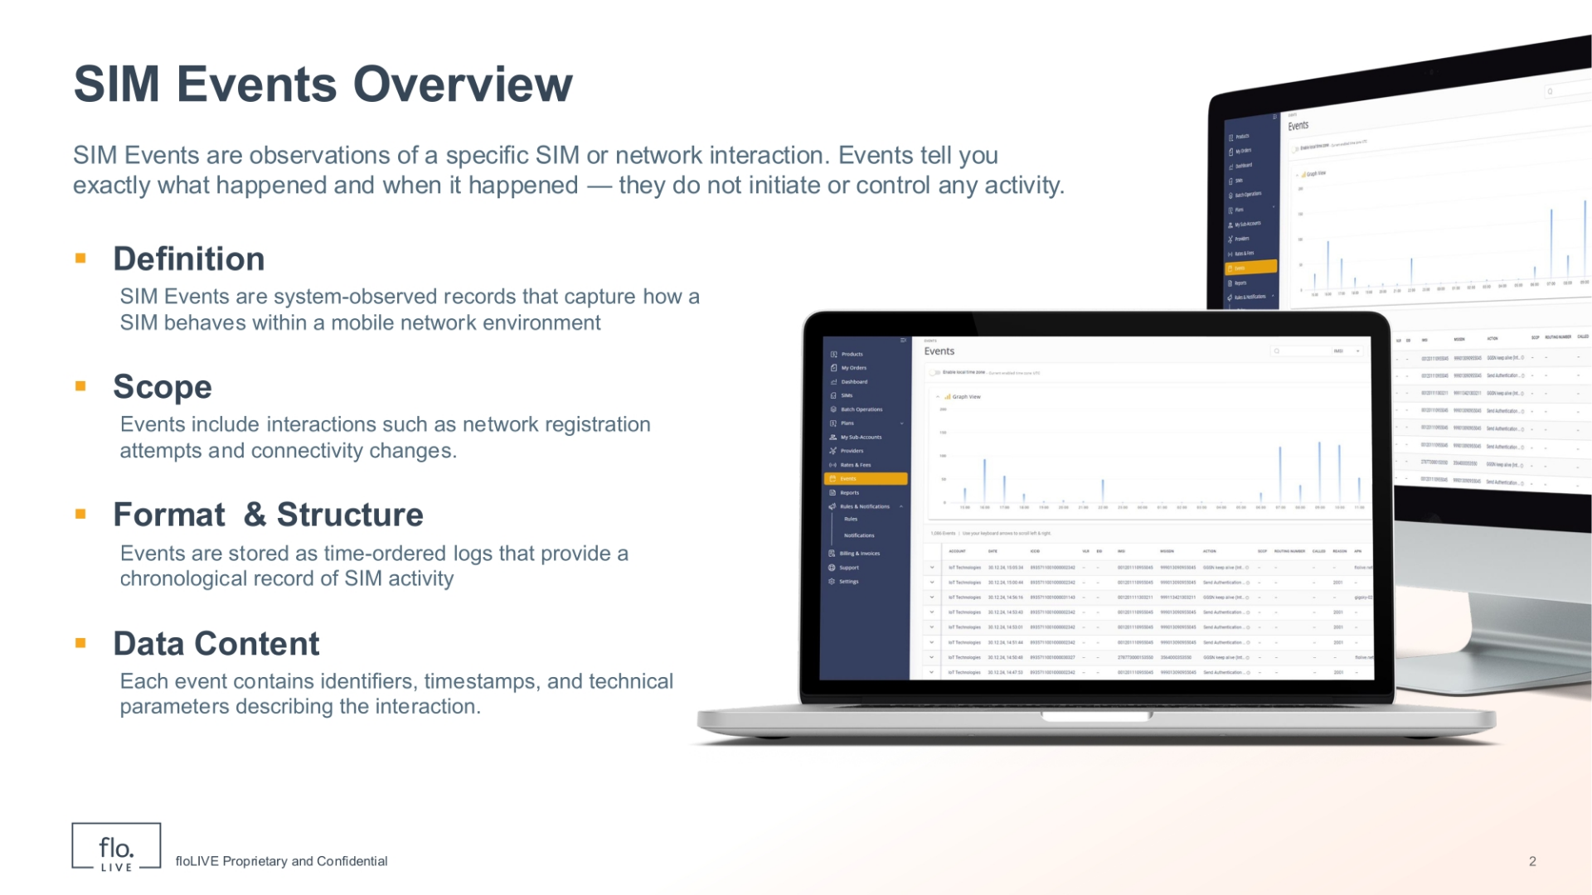
Notes:
SIM Events are observations of specific SIM or network interactions that describe how a SIM behaves within a mobile network environment. Simply put, SIM events describe exactly what happened and when, without initiating or controlling any activity. These events include interactions such as network registration attempts and connectivity changes. All events are stored as time-ordered logs to provide a chronological record of SIM activity. Each event contains essential identifiers, timestamps, and technical parameters that describe the interaction.

Slide 4
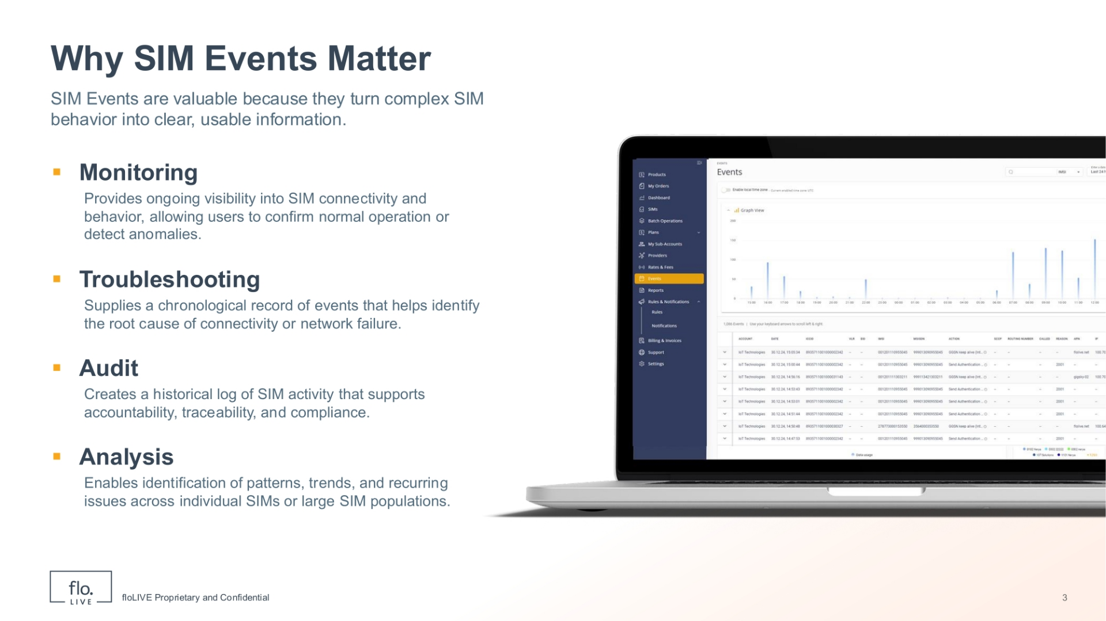
Notes:
SIM Events are important because they help you understand SIM activity in a simple way. Monitoring SIM Events enables you to see if the SIM is working normally. . You can use SIM events to troubleshoot issues and find the cause of connection or network problems. Events also enable you to perform auditing, by keeping a history of all SIM activity over time. . And finally you can analyze events to identify patterns and repeated issues. By understanding SIM Events, you can quickly understand what happened and decide what to do next.

Slide 5
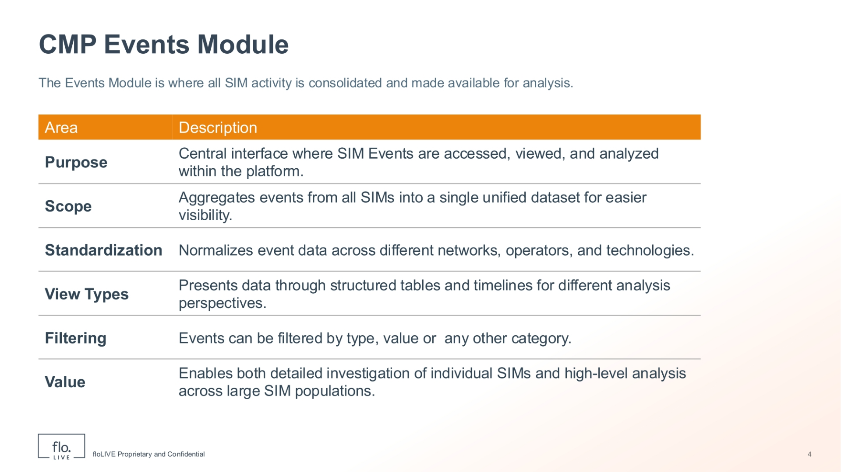
Notes:
The CMP Events Module is the central place for all SIM activity. It allows you to access, view, and analyze SIM events in a single consolidated table. Event data is normalized across networks and technologies, to ensure that event information is displayed in a consistent way. You can view event data either in table format for detailed data analysis or alternatively as a timeline to understand activity over time. You can also filter events to focus on what is relevant for your analysis. These 2 view types enable you to perform both detailed investigation and high-level analysis efficiently.

Slide 6
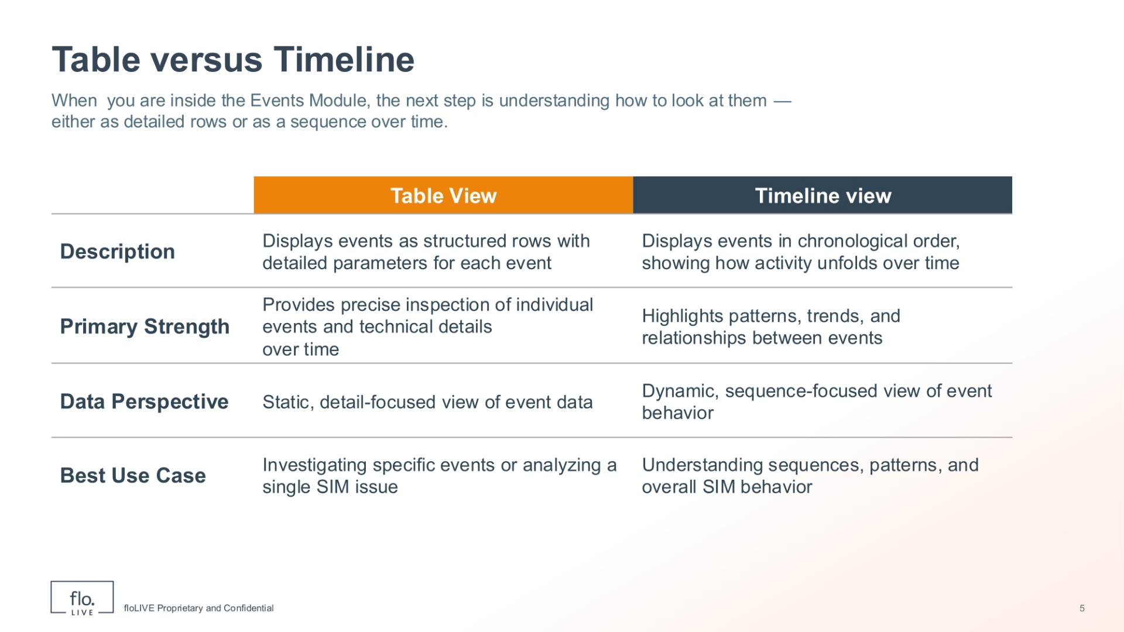
Notes:
When working within the Events Module, understanding how to view your data is crucial, whether as detailed rows or as a sequence over time. The Table View displays events as structured rows, complete with detailed parameters for each event. This format enables precise inspection of individual events and technical details and is suitable for analysing a single SIM issue. In contrast, the Timeline View displays events in chronological order, illustrating how activity unfolds over time. This view format highlights patterns, sequences,trends, and relationships between events, offering a dynamic, sequence-focused view of SIM behaviour.

Slide 7
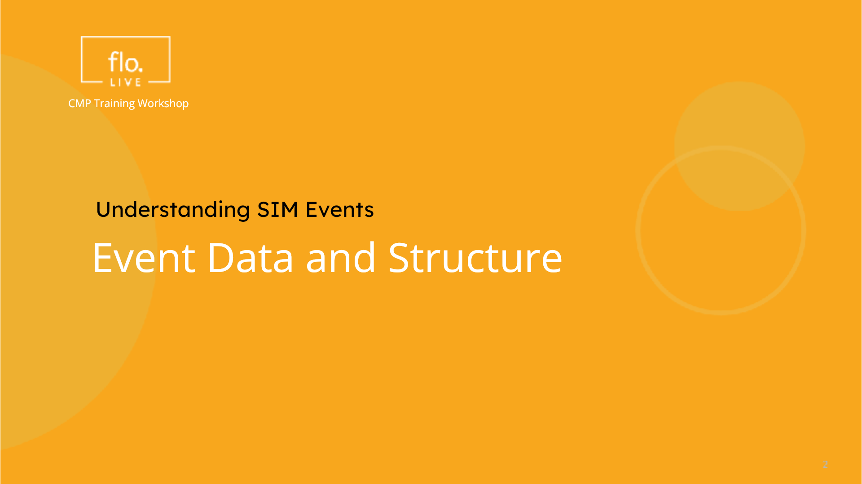
Notes:
Now that we understand the importance of SIM Events, let's explore event data and its structure in more detail.

Slide 8
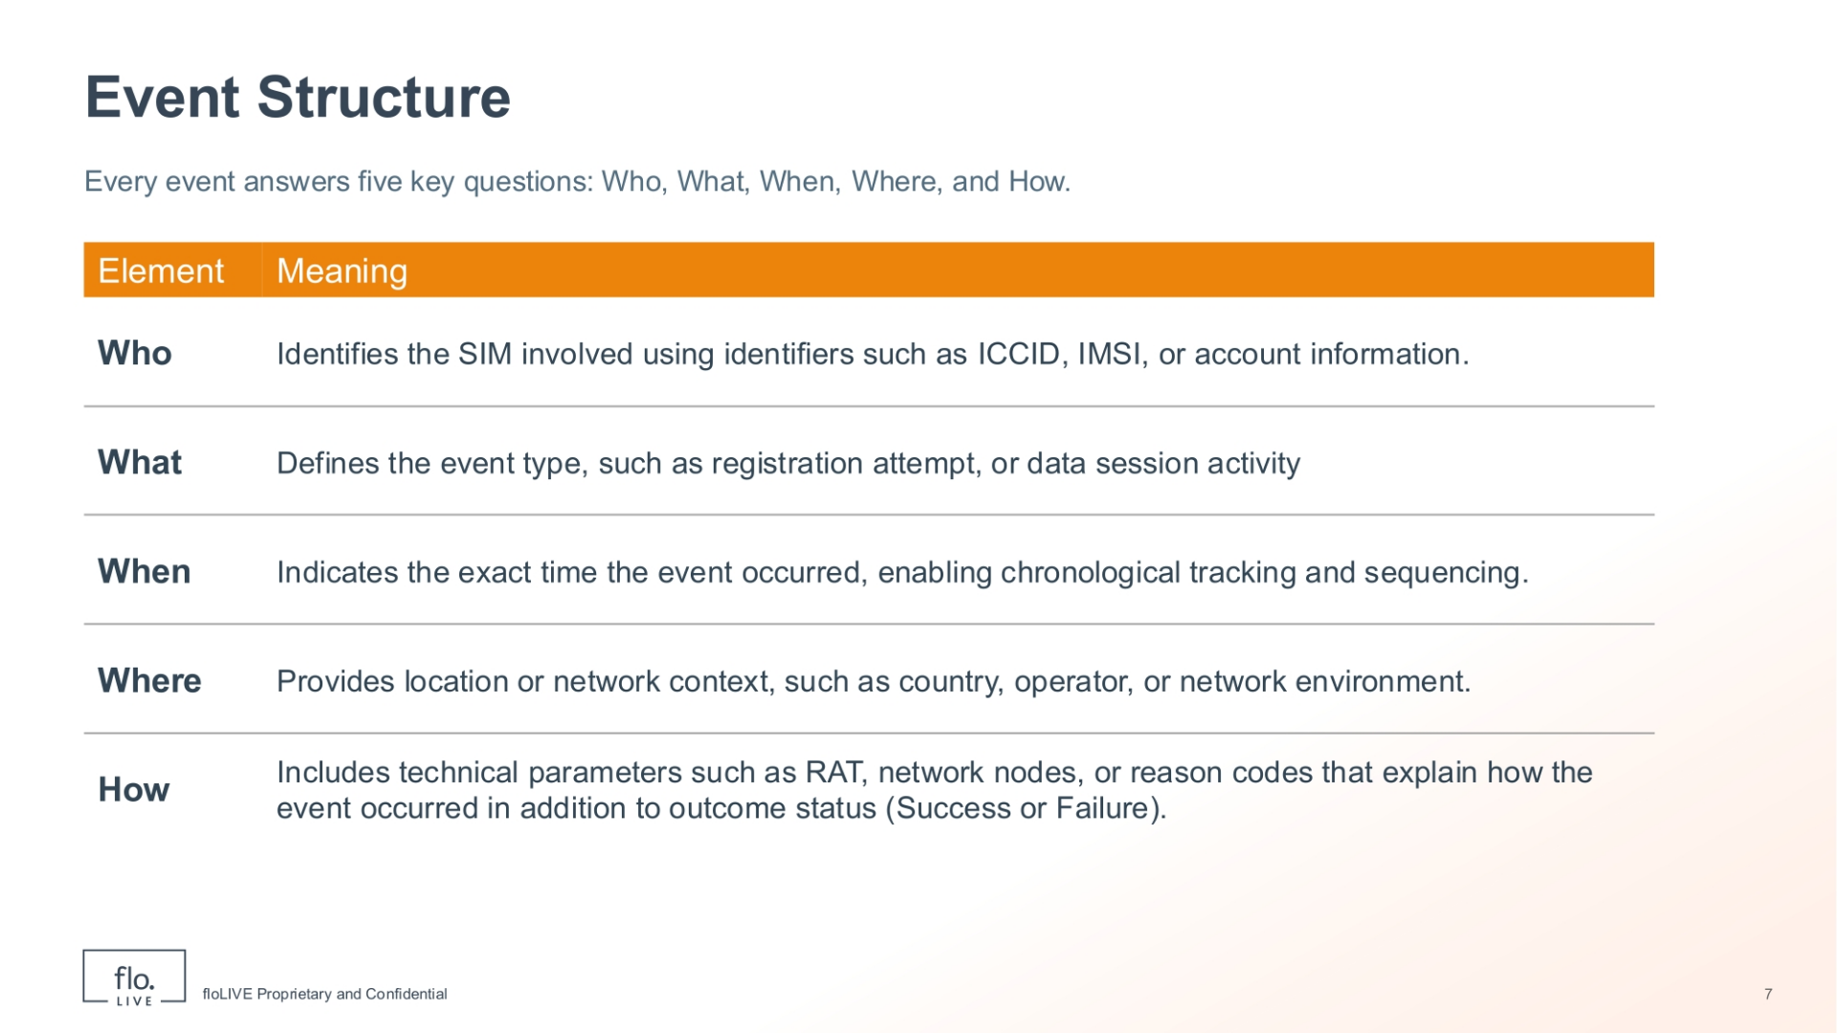
Notes:
Every event provides a comprehensive answer to five key questions. These 5 questions are: Who, What, When, Where, and How. The 'Who' question identifies the specific SIM involved, using identifiers such as ICCID, IMSI, or account information. The 'What' question defines the event type, such as a registration attempt or data session activity. The 'When' question indicates the exact time the event occurred, enabling precise chronological tracking and sequencing. The 'Where' question provides the location or network context, including country, operator, or network environment. Finally, the 'How' question provides technical details about the event such as Radio Access Technology, network nodes, or codes that explain how the event occurred and its outcome status, (whether success or failure).

Slide 9
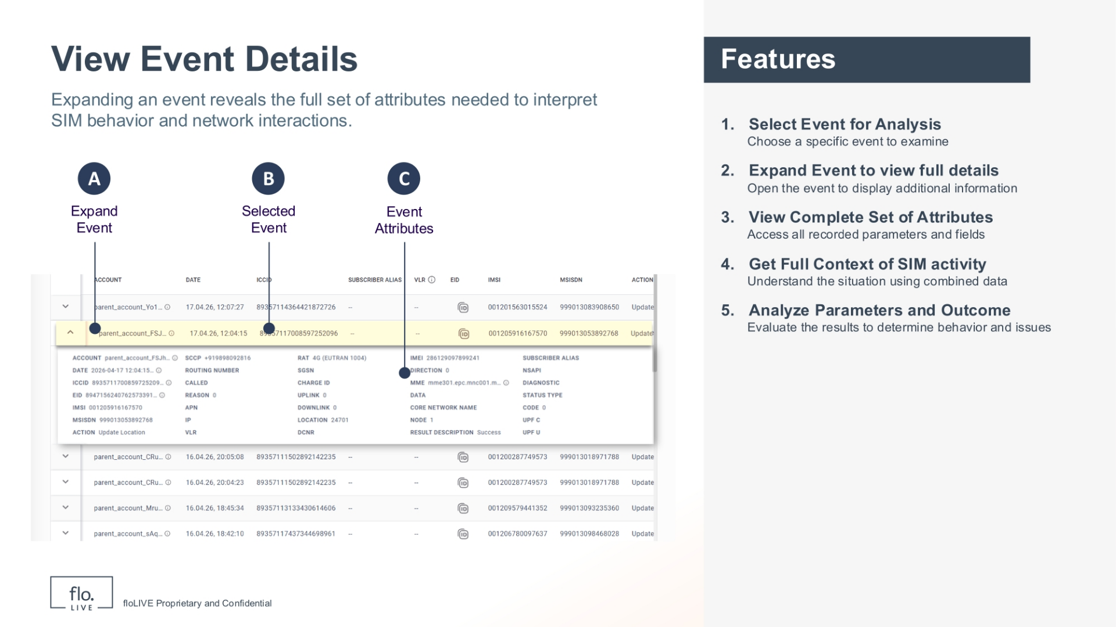
Notes:
When you click an item in the table the Event Details box is displayed. This feature enables you to view the full context of the Event including identifiers, attributes, interactions, network information, and technical parameters. The Event details box is important because it helps you to understand what happened during the event and it enables you to perform a detailed analysis of outcomes and behaviour.

Slide 10
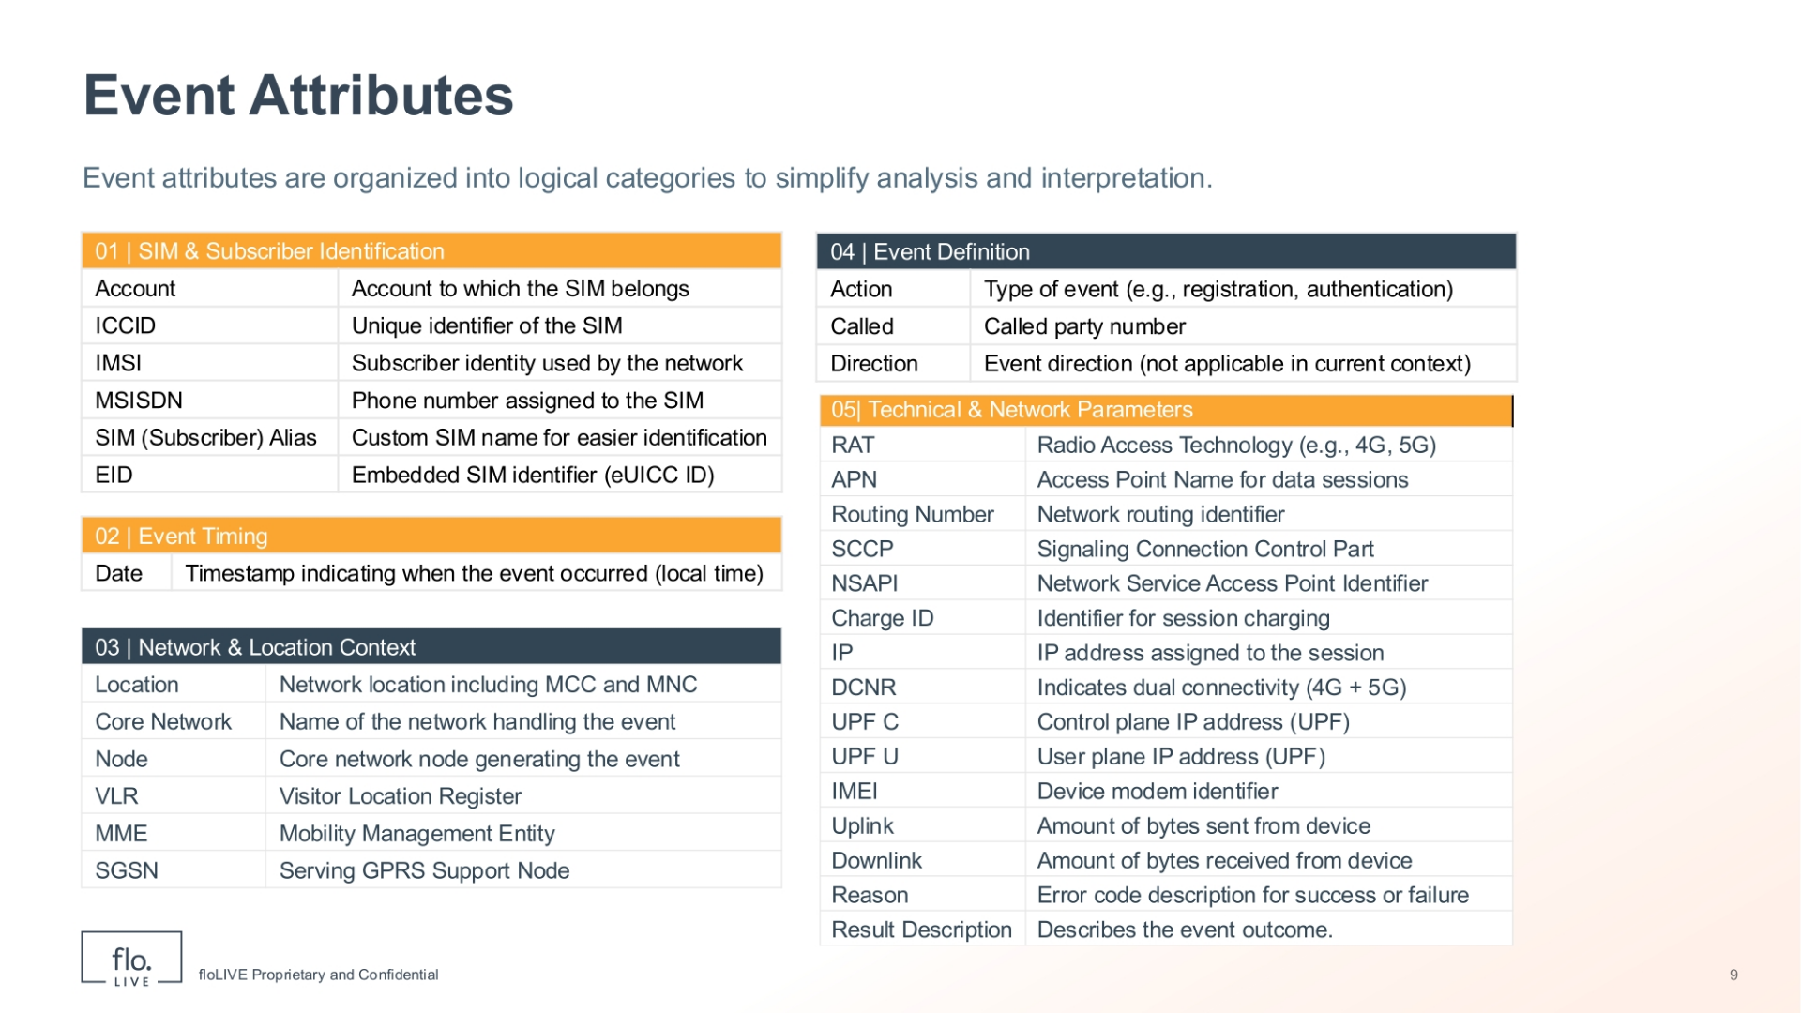
Notes:
Lets drill-down into the different types of event attributes. To simplify our analysis, we can organize event attributes into five logical categories. Table 1 shows the 'SIM & Subscriber Identification' attributes. These atributes define who the event relates to, including account, ICCID, IMSI, MSISDN, SIM Alias, and EID. Table 2 shows the 'Event Timing' attribute which displays the specific date and timestamp of when the event occurred. The 'Network & Location Context' attributes are displayed in Table 3. These attributes describe the event location as well as the core network, node, VLR, MME, and SGSN. Table 4 shows 'Event Definition' attributes. These attributes explain what action occurred, the action type, the called party number, and event direction. Finally, the 'Technical & Network Parameters' (shown in Table 5) describe how the event was processed at the system level.

Slide 11
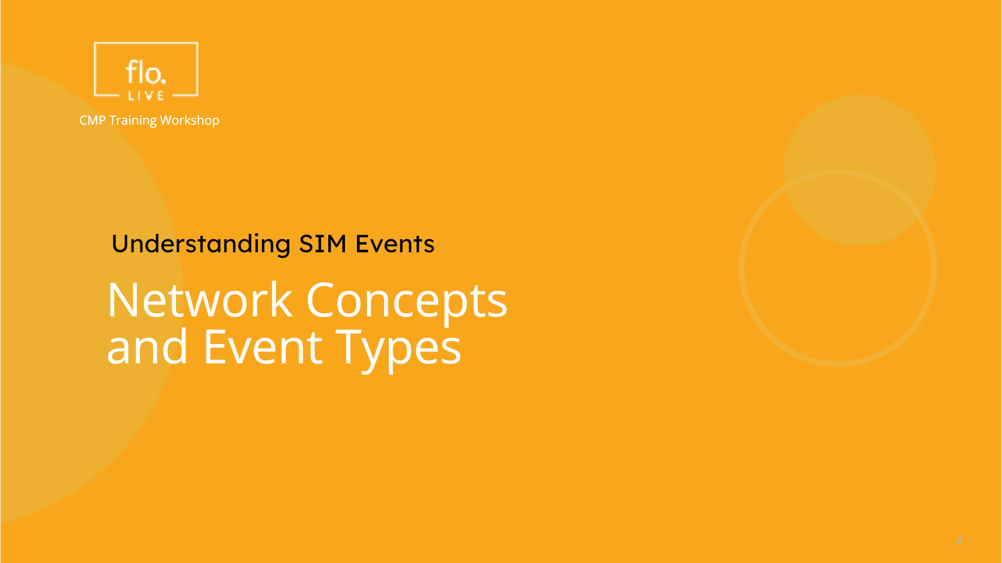
Notes:
Lets move on to discuss various network concepts and event types.

Slide 12
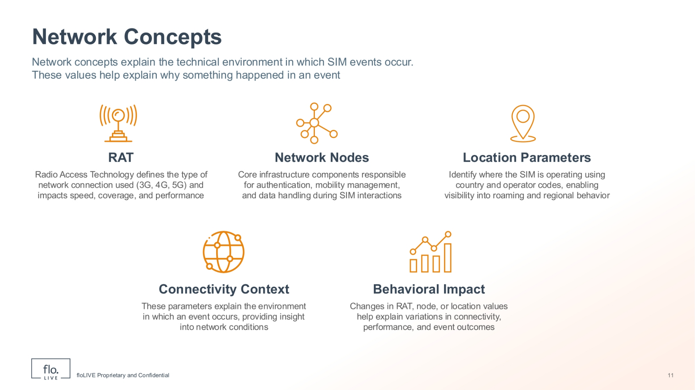
Notes:
Network concepts are essential for understanding the technical environment in which SIM events occur, and they help to clarify why something happened. Radio Access Technology (also known as RAT), defines the type of network connection used, such as 3G, 4G, or 5G. The RAT technology impacts the speed, coverage, and performance of SIM activity. Network Nodes are core infrastructure components and are responsible for authentication, mobility management, and data handling during SIM interactions. Location Parameters identify where the SIM is operating using country and operator codes. These parameters provide visibility into roaming and regional behaviour. Connectivity Context parameters explain the environment in which an event occurs and provide insight into network conditions. Finally, Behavioral Impact refers to how changes in RAT, node, or location values help explain variations in connectivity, performance, and event outcomes.

Slide 13
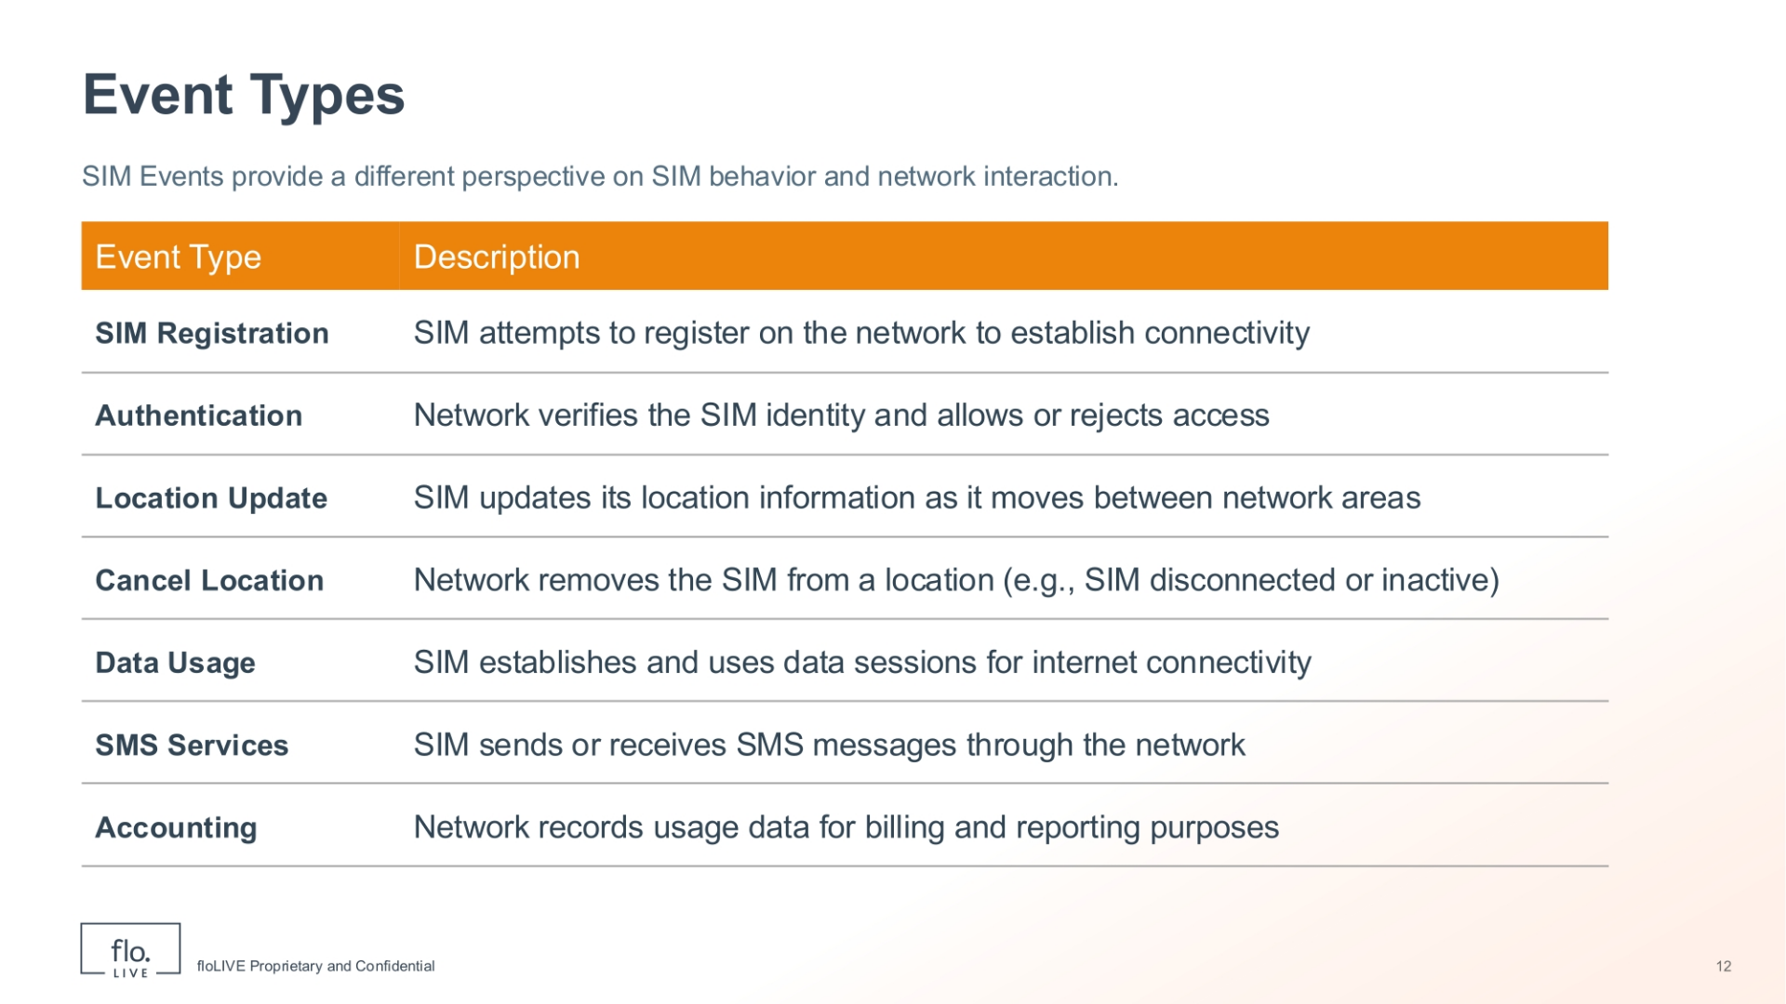
Notes:
Now we take a look at the different event types and network interactions. SIM Registration events occur when a SIM attempts to register on the network to establish connectivity. Authentication involves verification of the SIM identity to either allow or reject access to the network. Location Update events track SIM location information as it moves between network areas. A Cancel Location event occurs when the network service provider removes a SIM from a specific location, for example, when it becomes disconnected or inactive. Data Usage events indicate when a SIM establishes and uses data sessions for internet connectivity. SMS Service events occur when a SIM sends or receives SMS messages through the network. Lastly, Accounting events record usage data for billing and reporting purposes.

Slide 14
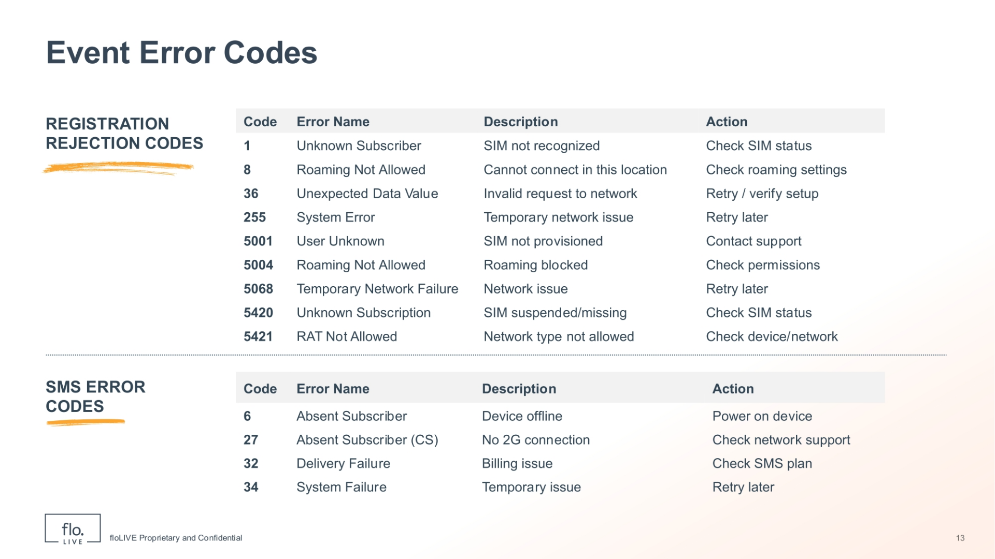
Notes:
Understanding common Error codes helps you to identify failure causes and determine appropriate next steps. During registration, an 'Unknown Subscriber' error means the SIM is not recognised, while 'Roaming Not Allowed' prevents connection in the current location. Other registration errors such as 'System Error' or 'Temporary Network Failure', often suggest temporary issues that might be resolved after a retry. For SMS events, 'Absent Subscriber' indicates an unreachable device, and 'Delivery Failure' may imply billing or service issues.

Slide 15
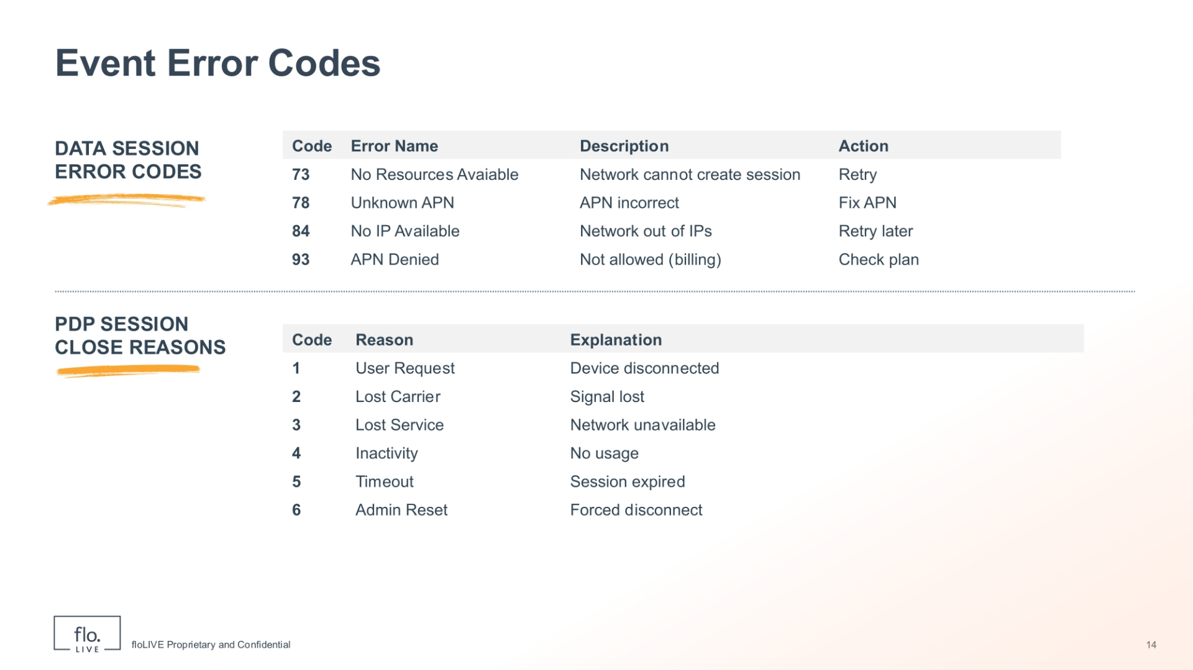
Notes:
Lets continue to review other types of event error codes. Data session error codes explain why a data connection could not be established. For example, an 'Unknown APN' indicates an incorrect access point name, while 'No IP Available' means the network cannot assign an IP address. Some errors, such as 'APN Denied', may stem from configuration or billing restrictions. Now lets discuss the PDP session close reasons. These error codes describe why an active session was terminated. For example, user request, inactivity, lost carrier or network unavailability. In summary, by reviewing error codes you can understand a wide range of problems and pinpoint their origin whether it be the device, network, or a configuration issue.

Slide 16
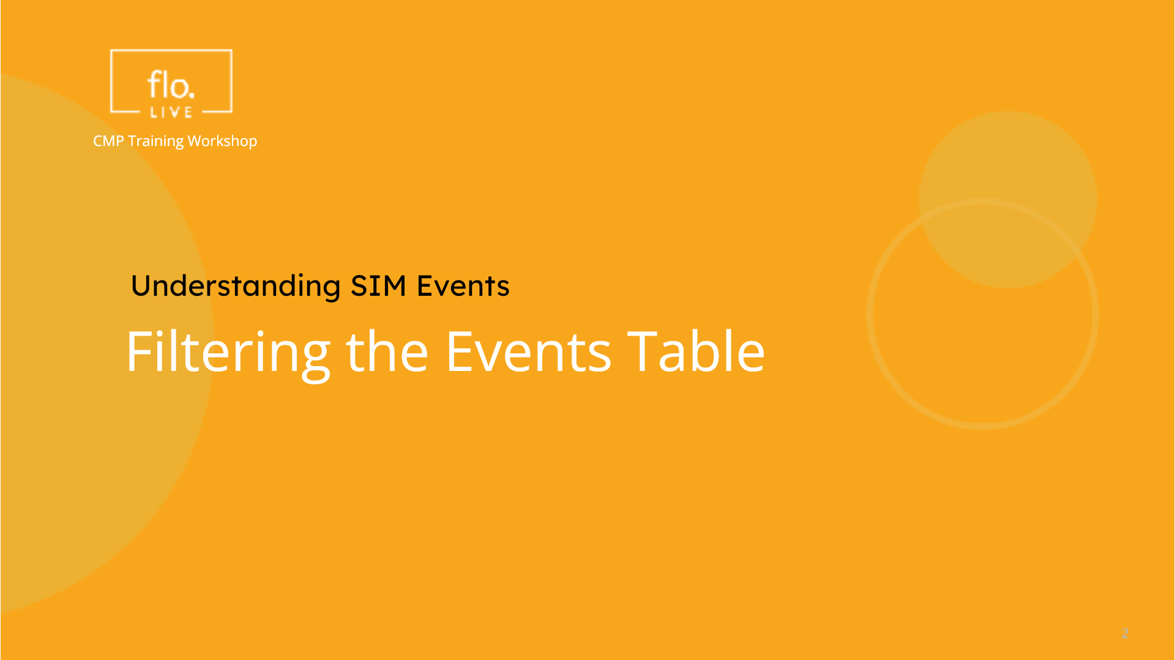
Notes:
In the next section we find out how to filter the events table based on selected criteria

Slide 17
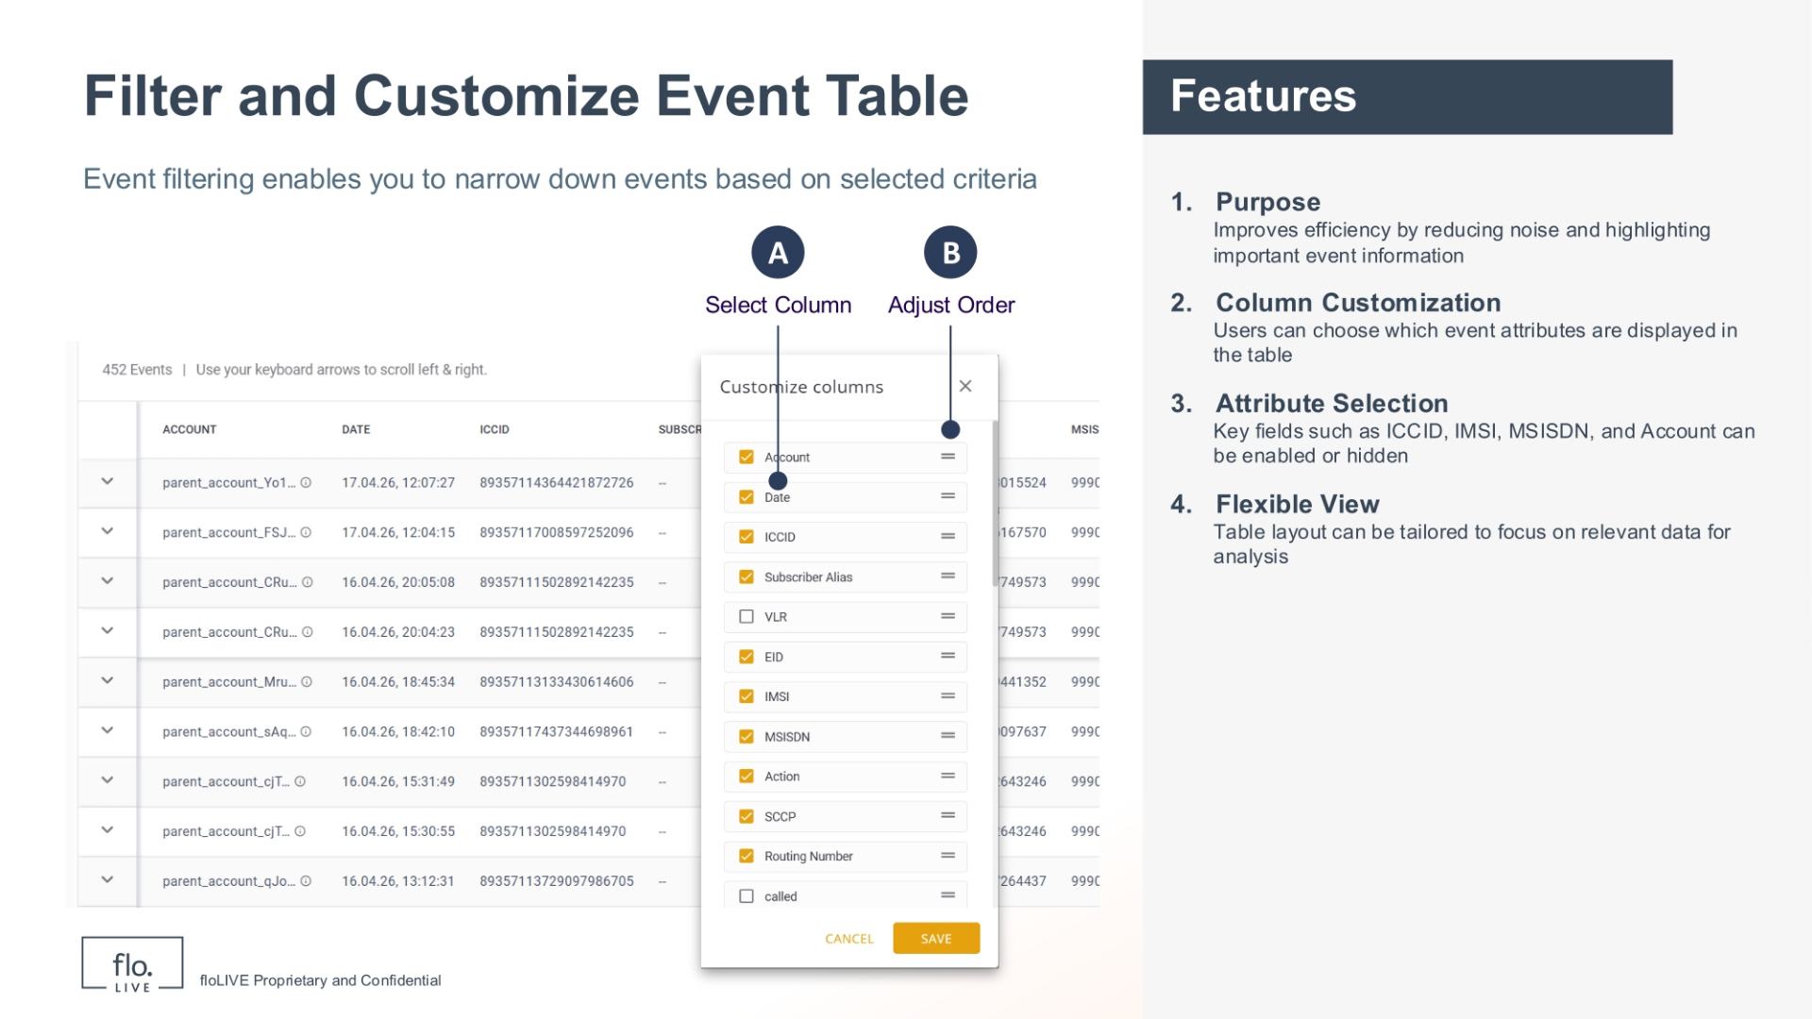
Notes:
Event filtering enables you to narrow down events based on selected criteria. . This means you can choose which event attributes are shown in the table and which are hidden from view. When you display the Filter Panel, simply scroll through the list of atrributes and select the appropriate parameters. In addition, you can customize the order of the columns by simply dragging the attribute control up or down. This feature is useful because it enables you to display only the information you need and hide all other attributes

Slide 18
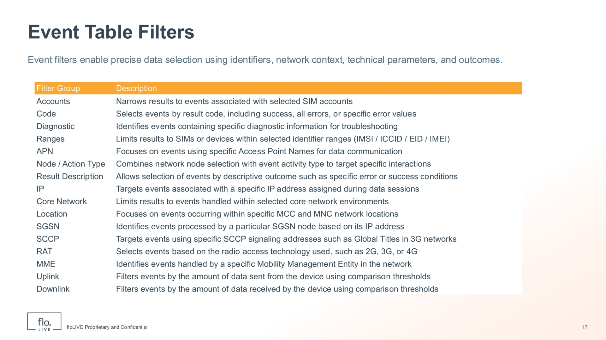
Notes:
This table shows the available filters you can use to narrow event data. We wil not go through each filter in detail, but instead we focus on how they are used in practice. Each filter helps you focus on specific information, such as SIM identifiers, network context, or technical parameters. You can combine multiple filters to narrow the results and find relevant events. This makes it easier to isolate issues and work with smaller, focused data sets.

Slide 19
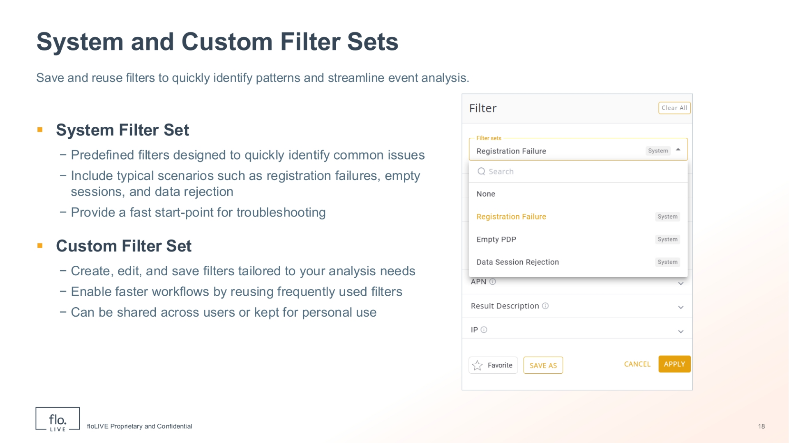
Notes:
Another useful feature of the Filter Panel is called a "Filter Set" which allows you to save and reuse frequently used filter selections. , System filter sets are predefined and enable you to quickly identify common issues such as registration failures, empty sessions, and data rejection scenarios. These predefined system filters provide you with a fast starting point for troubleshooting. Alternatively you can create and edit your own Custom Filter Sets. Custom filter sets are tailored to your specific analysis needs and they can be reused to accelerate any type of analysis workflow or shared with different users. By leveraging both system and custom filter sets, you can efficiently organise your analysis and quickly focus on the most relevant events.

Slide 20
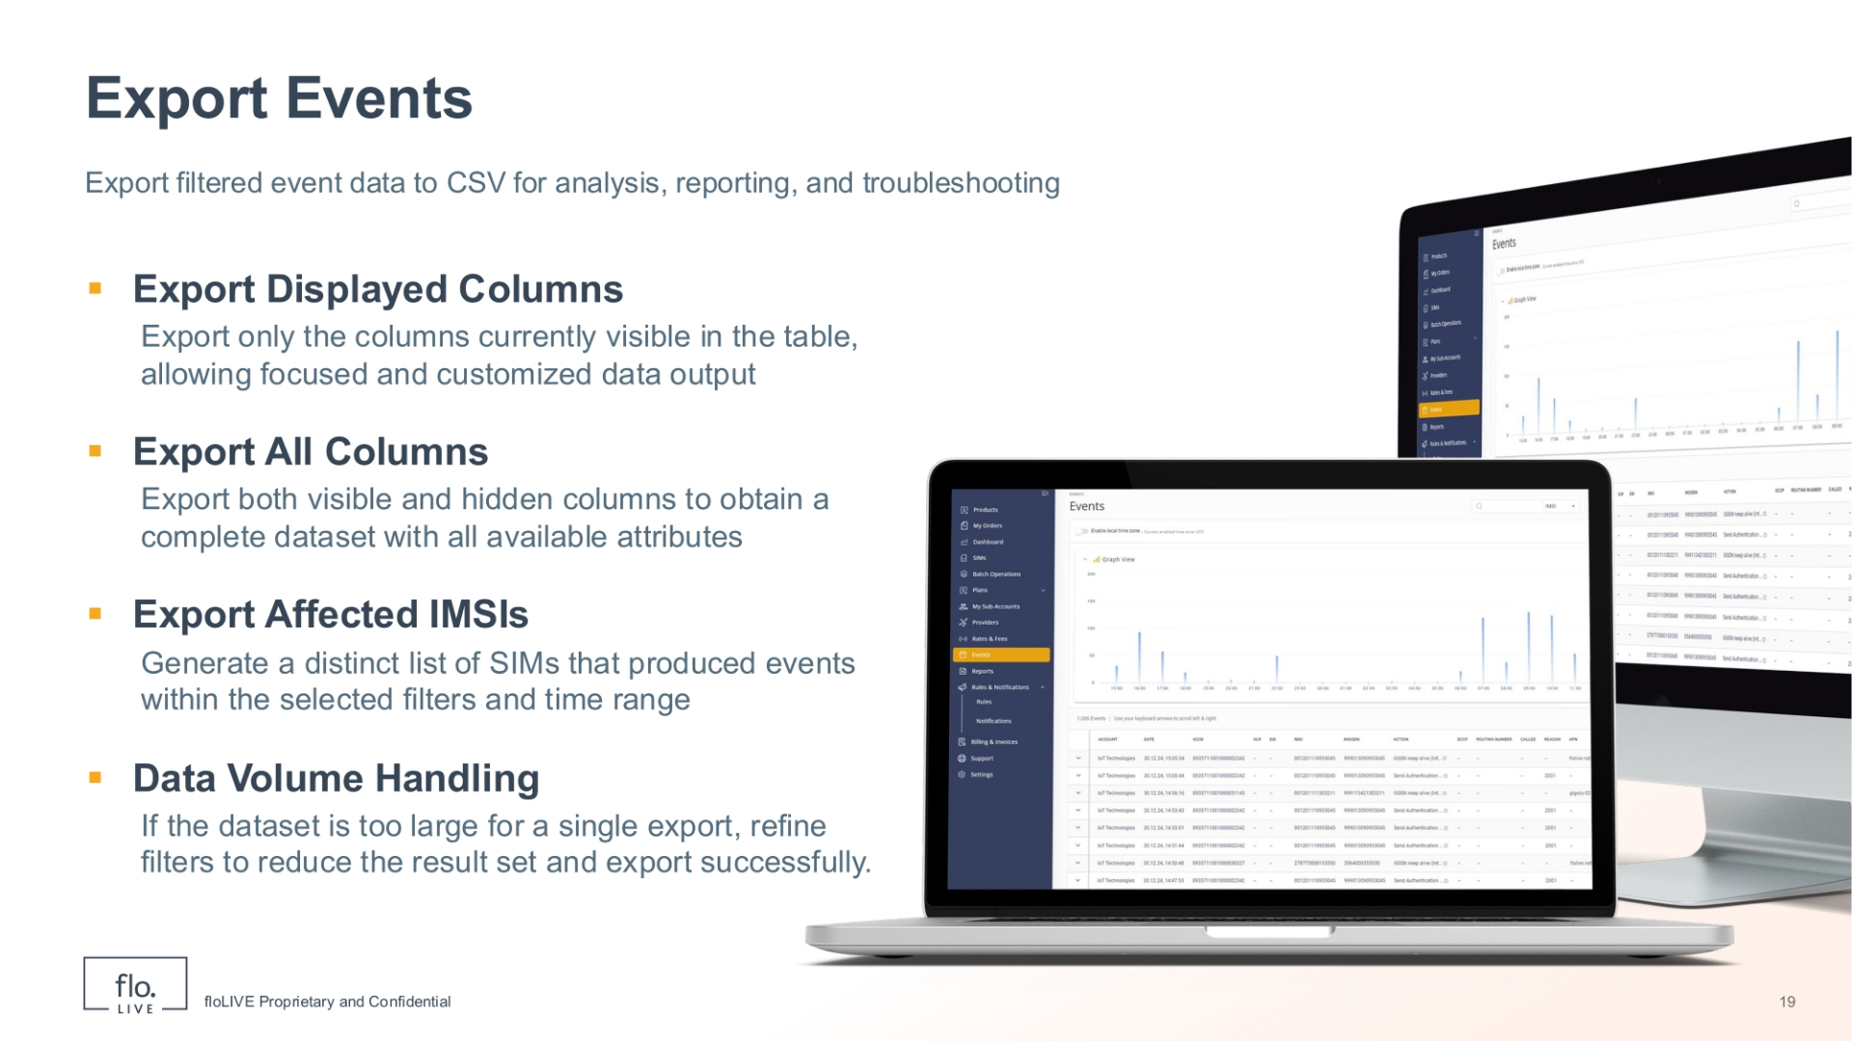
Notes:
After you filter and analyse events, you can export your data to a CSV file for analysis, reporting, and troubleshooting. When you select the 'Export Displayed Columns' option, the CSV file will include only the fields currently visible in the table. When you select the 'Export All Columns' option, your CSV file will contain a complete dataset by including both visible and hidden fields. There is also an option to 'Export Affected IMSIs', which generates a file for the SIMs produced by the selected filters and time range. You should note that if the dataset is too large for a single export, you will be prompted to refine the filters to reduce the result set.

Slide 21
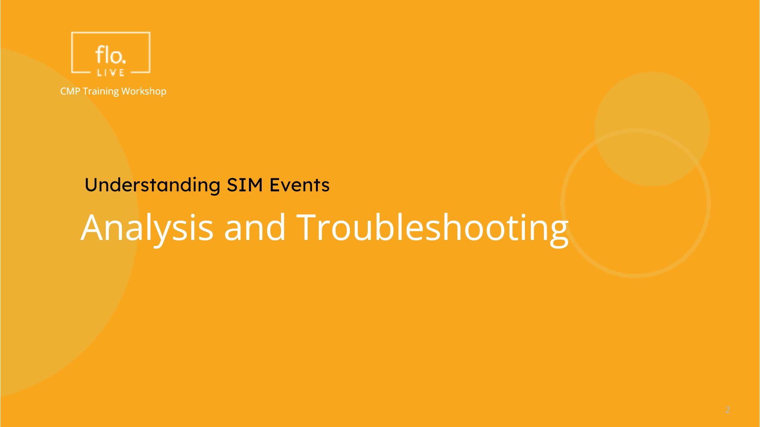
Notes:
In this section we learn how to analyze and troubleshoot both single events, as well as event sequences.

Slide 22
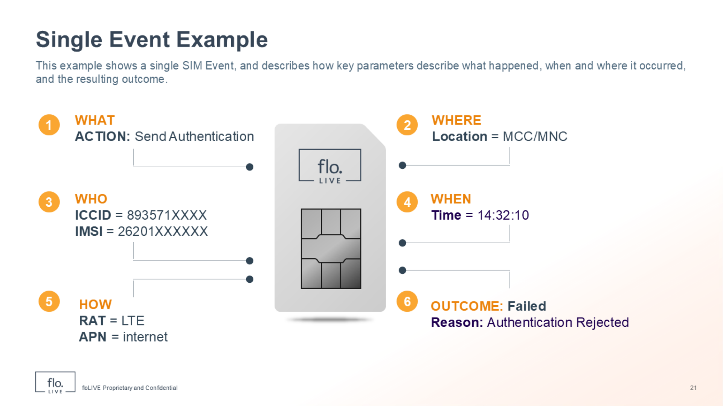
Notes:
This example shows you how to analyse a single SIM Event. Take a look at the diagram and notice how the event is broken down into its core components. The 'WHAT' label identifies the action as 'Send Authentication'. The 'WHERE' label specifies the location using the Mobile Country Code and the Mobile Network Code. The who label specifies the SIM by identifying the ICCID and IMSI attributes. The 'WHEN' label provides the exact time of the event. The 'HOW' label describes the technical parameters. In this example,we see that the RAT uses LTE and the APN is connected to the 'internet'. Finally, the 'OUTCOME' label indicates 'Failed', with the reason being 'Authentication Rejected'

Slide 23
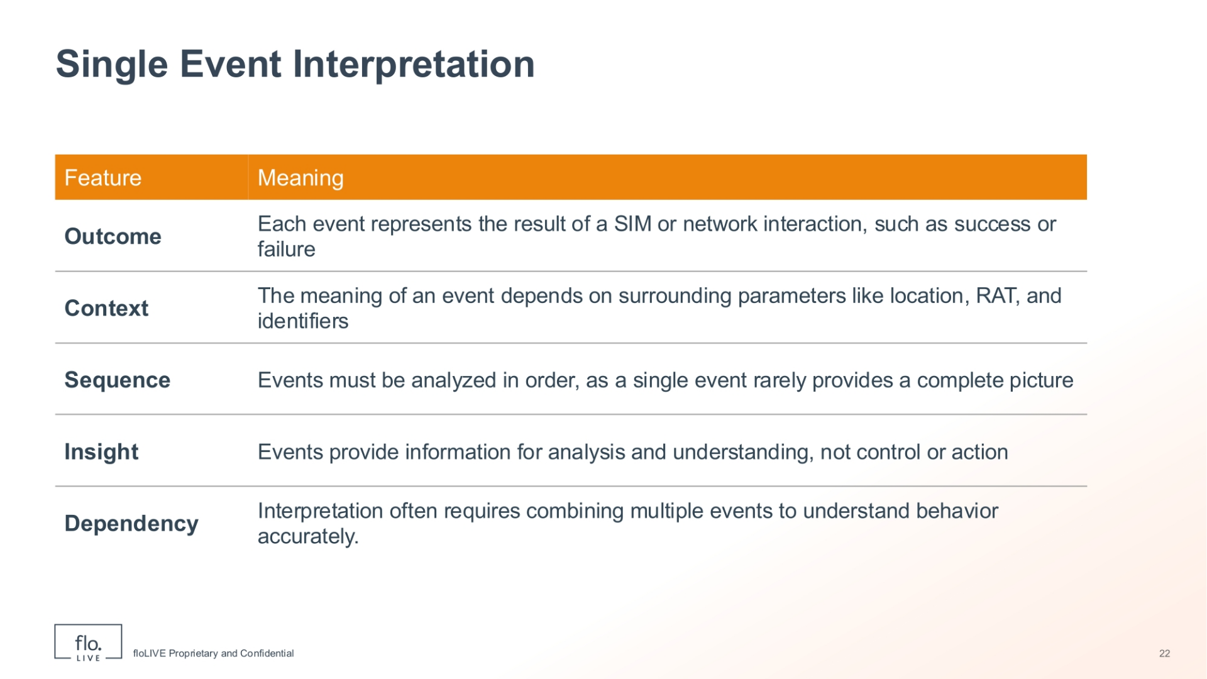
Notes:
This slide shows how to interpret a single event. Start with the outcome, which tells you what happened, such as success or failure. Next is context, which explains the conditions of the event, like location, network type, and identifiers. The most important step is sequence. A single event is not enough. You must look at events both before and after in order to understand the full picture. Events also provide insight, helping you understand SIM behavior, but remember, they do not fix issues directly. Finally, dependency means you often need multiple events together to fully understand what is happening.

Slide 24
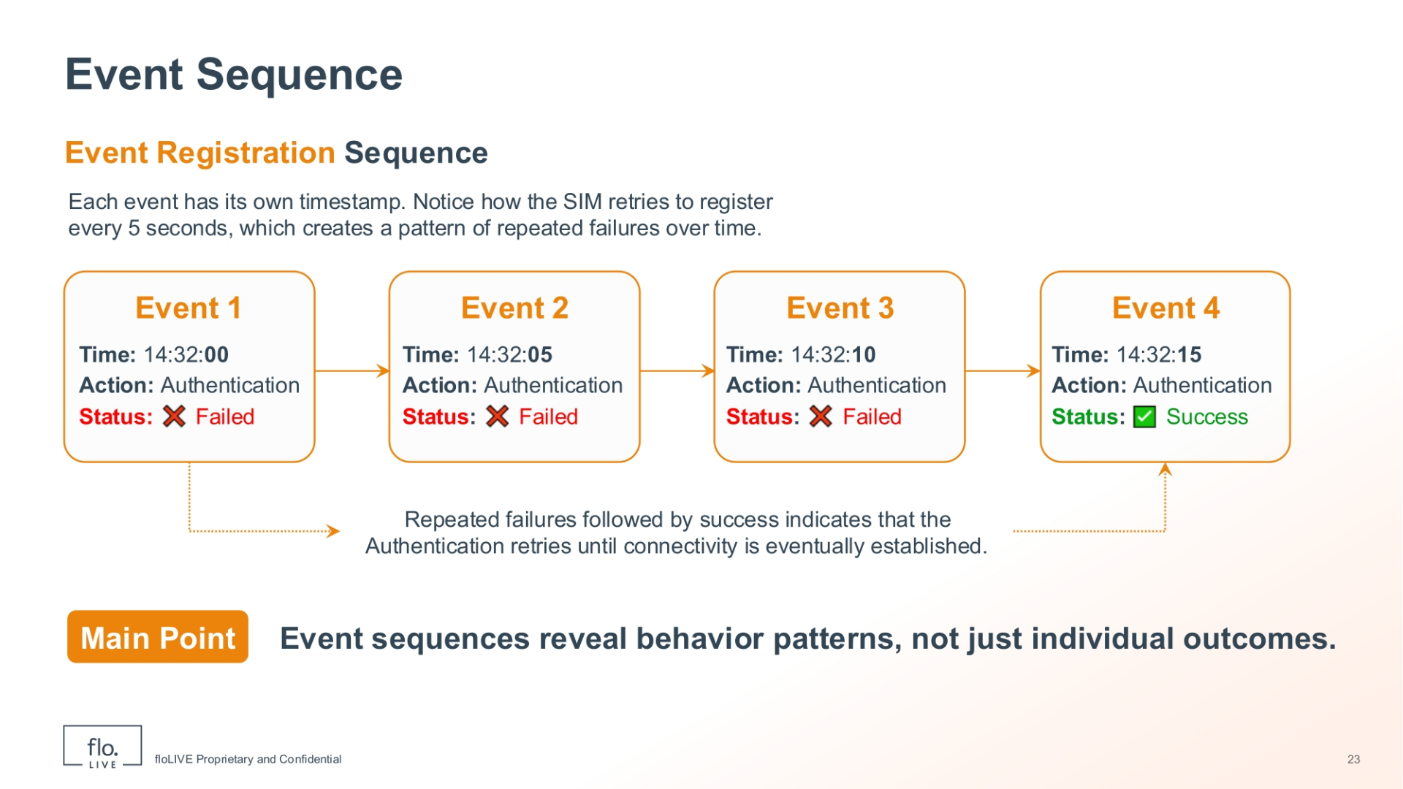
Notes:
This is an example of an event registration sequence, and it shows how individual events unfold over time. Each event has its own timestamp. You should notice that the SIM attempts to register every five seconds, leading to a series of failed authentication attempts. This sequence reveals that eventually connectivity is established, It demonstrates that event sequences can reveal crucial behaviour patterns, not just individual outcomes. This kind of analysis provides a deeper understanding of the SIM's interaction with the network.

Slide 25
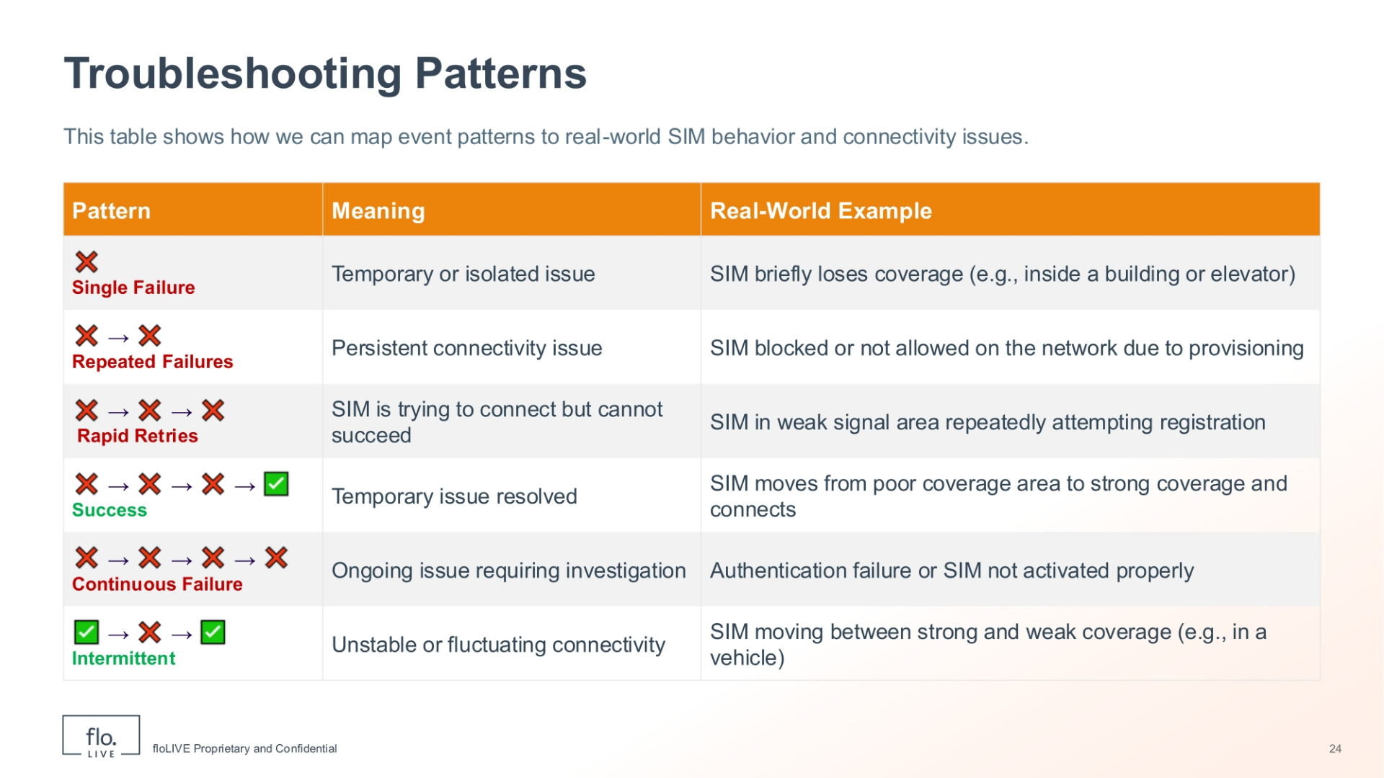
Notes:
In this table we can map common event patterns to real-world SIM behaviour and connectivity issues. Notice that a 'Single Failure' indicates a temporary or isolated issue, such as a SIM briefly losing coverage inside a building. 'Repeated Failures' point to a persistent connectivity problem, like a SIM being blocked or not allowed on the network. 'Rapid Retries' suggest the SIM is attempting to connect but cannot succeed, often seen when a SIM is in a weak signal area. 'Success' after failures indicates a temporary issue has been resolved, for example, a SIM moving from poor to strong coverage. 'Continuous Failure' signifies an ongoing issue requiring investigation, such as authentication failure or an improperly activated SIM. Finally, 'Intermittent' patterns suggest unstable or fluctuating connectivity, like a SIM moving between strong and weak coverage in a vehicle.

Slide 26
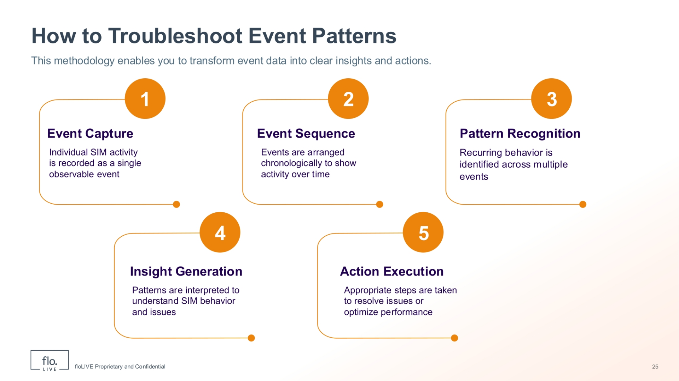
Notes:
This methodology provides a structured approach to transform event data into clear insights and actionable steps. The process begins with 'Event Capture', where individual SIM activity is recorded as a single observable event. Next, 'Event Sequence' involves arranging these events chronologically to show activity over time, revealing the order of interactions. Following this, 'Pattern Recognition' identifies recurring behaviour across multiple events, highlighting trends or anomalies. These patterns are then interpreted during 'Insight Generation' to understand SIM behaviour and underlying issues. Finally, 'Action Execution' involves taking appropriate steps to resolve identified issues or optimise performance, completing the troubleshooting cycle.

Slide 27
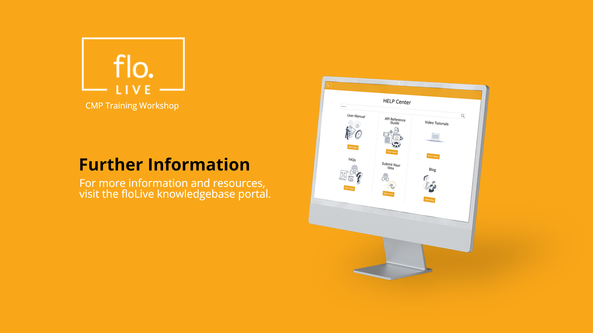
Notes:
Thank you for watching this video tutorial. For more information about the CMP system, make sure you visit our Knowledge-base that is accessible directly from the CMP Portal.

